Slide 1
Airline Reservation Analysis
Mr. Sarvesh Pandit

Slide 2
Objective
To analyze airline performance by visualizing total revenue generated by each airline and identifying the top-performing carriers.
The dashboard aims to provide insights into revenue contribution, pricing trends, flight operations, and booking patterns, helping management make data-driven decisions to optimize routes, improve profitability, and enhance customer satisfaction.

Slide 3
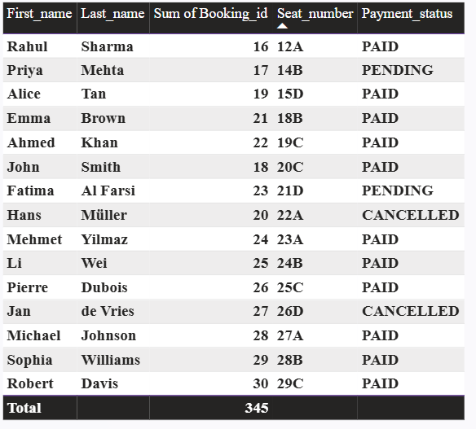
Query 1:Show all passengers and their bookings

Slide 4
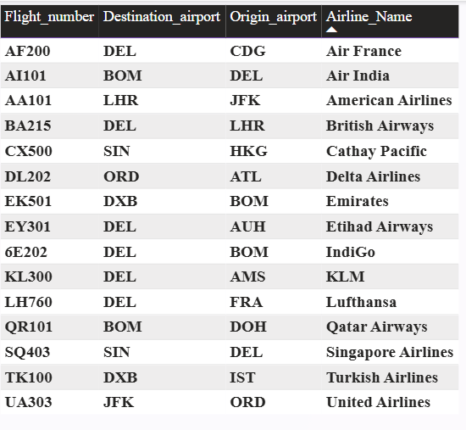
Query 2:List all flights with their airline name

Slide 5
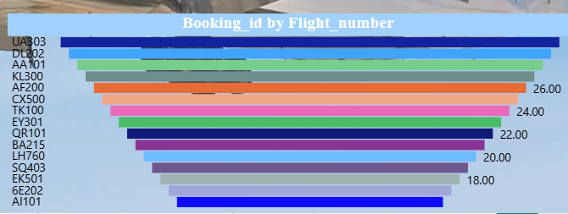
Query 3:Count the number of bookings for each flight

Slide 6
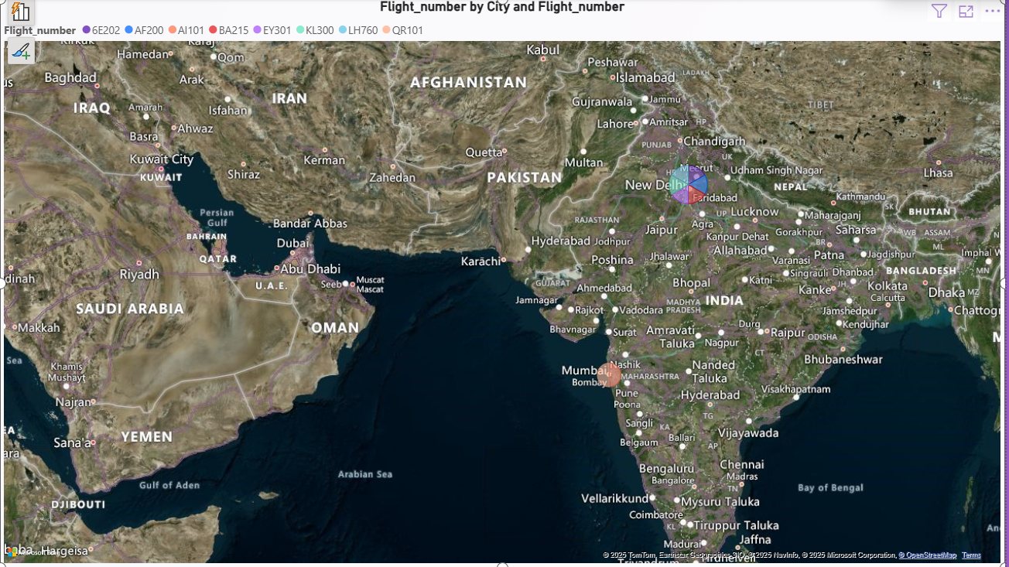
Query 4:Show flights departing from India

Slide 7

Query 5:Total revenue collected

Slide 8
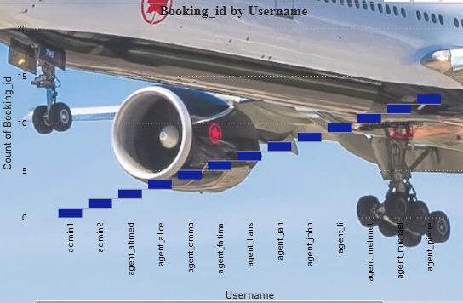
Query 6:Show which agent added each booking

Slide 9
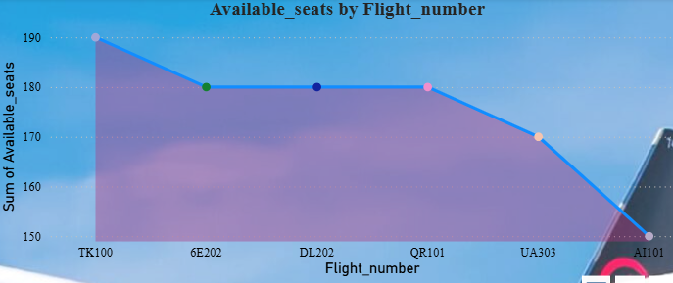
Query 7:Flights with available seats less than 200

Slide 10
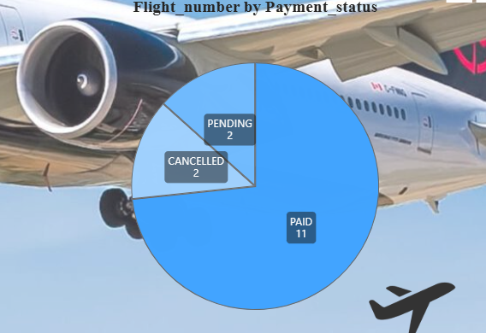
Query 8:Cancelled bookings with passenger names

Slide 11
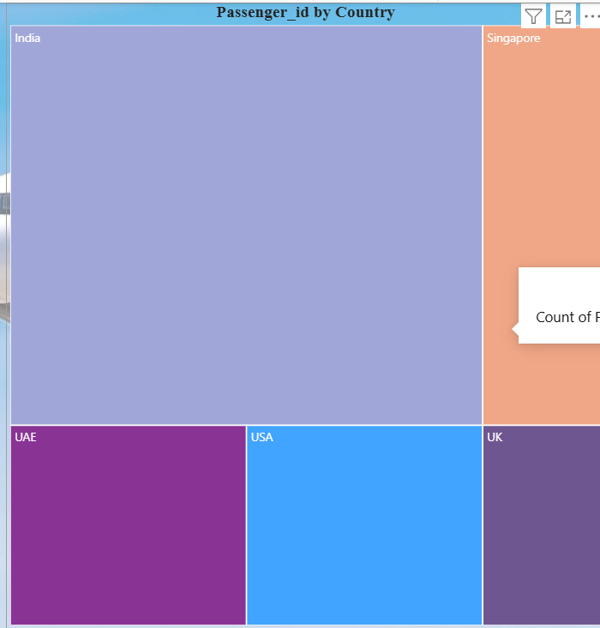
Query 9: Passengers by country

Slide 12
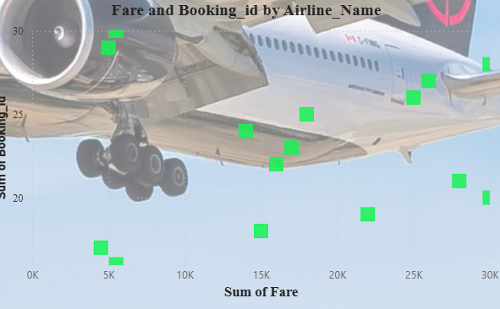
Query 10: Airline management wants to understand the relationship between SUM OF fares and the number of bookings across different airlines to determine whether higher fares impact booking volume.

Slide 13
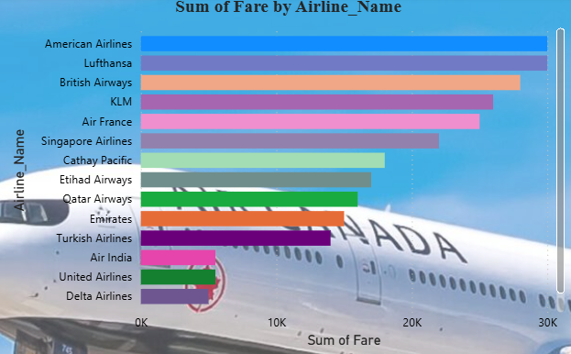
Query 11:Which airlines generate the highest revenue?

Slide 14
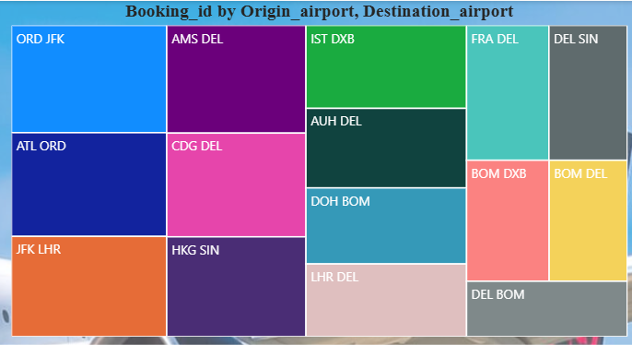
Query 12:Which routes are most popular among passengers?

Slide 15
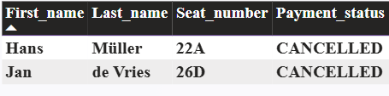
Query 12:Find passengers with pending payments

Slide 16
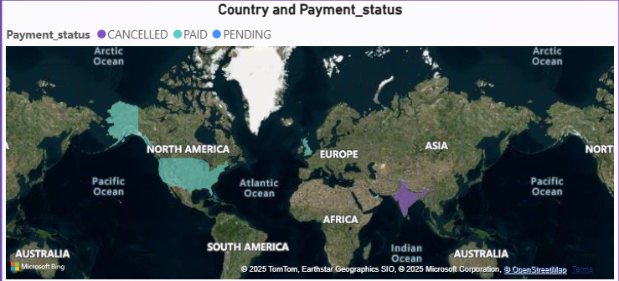
Query 13:How much revenue comes from each country?

Slide 17
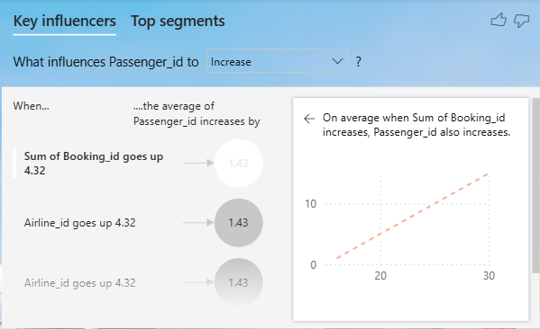
Query 14:Understanding and Driving Passenger Growth

Slide 18
Thank you

